Slide 1
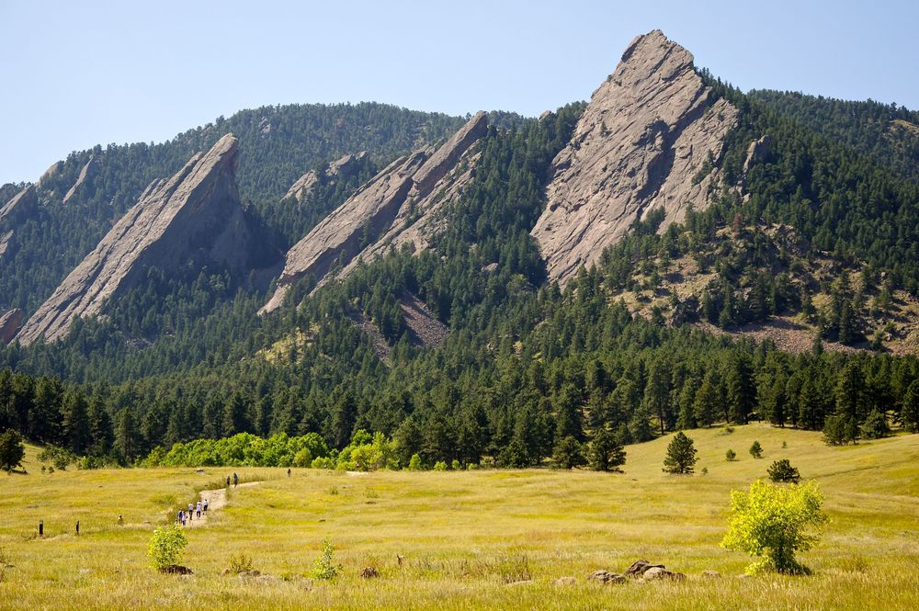
CSCI 1102 Computer Science 2
Meeting 19: Tuesday 4/6/2021
Quiz Review
Implementing Finite Partial Maps; BSTs

Slide 2
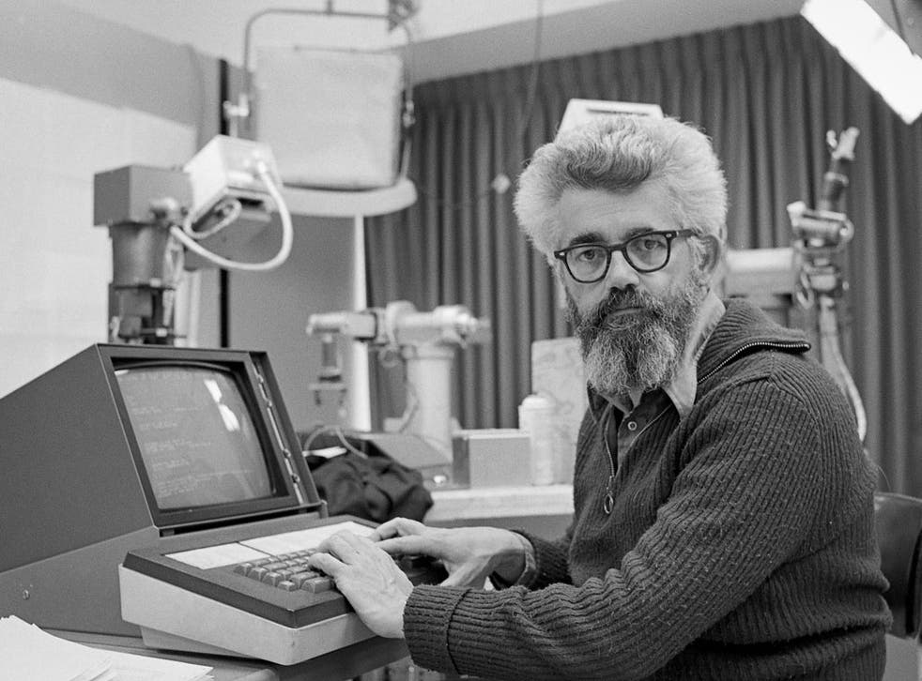
John McCarthy
Turing Award 1971

Slide 3
Inventor of LISP
Inventor of Automatic Memory Management (Garbage Collection)
Pioneer in AI

Slide 4
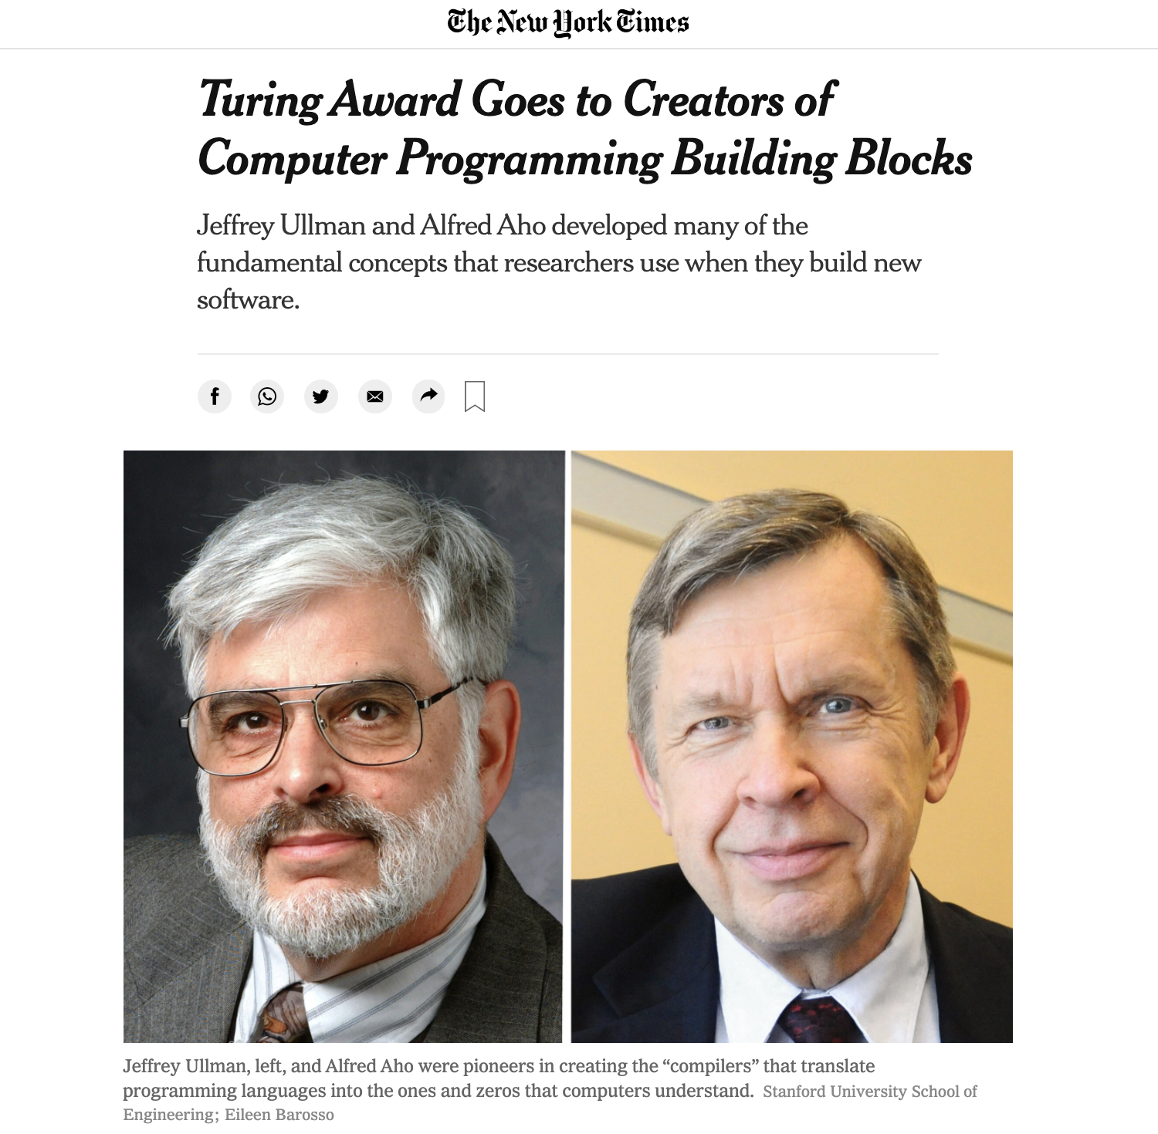

Slide 5

Google v Oracle
US Supreme Court (6-2) 4/5/2021:
Re-use of APIs (interfaces) are subject
to the fair use exception
of copyright law.

Slide 6
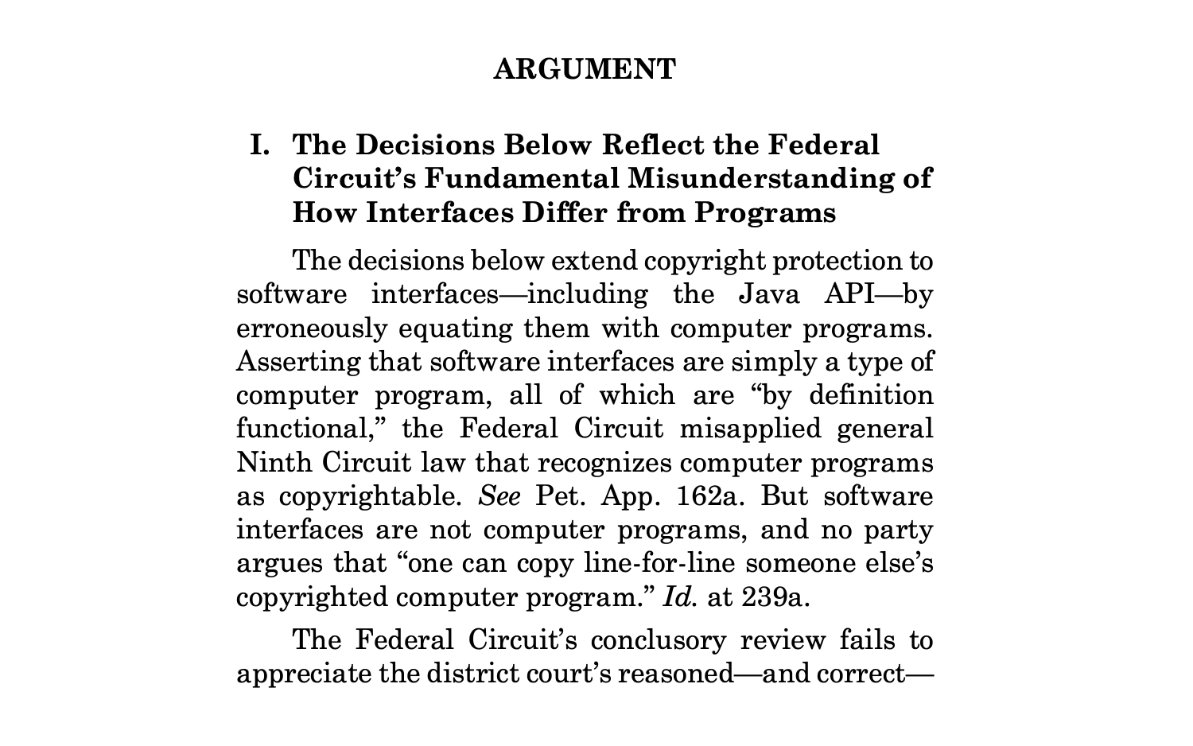

Slide 7
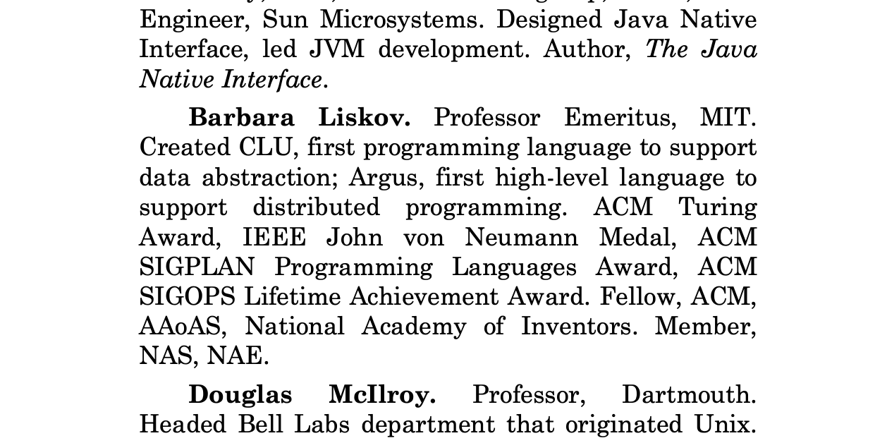

Slide 8
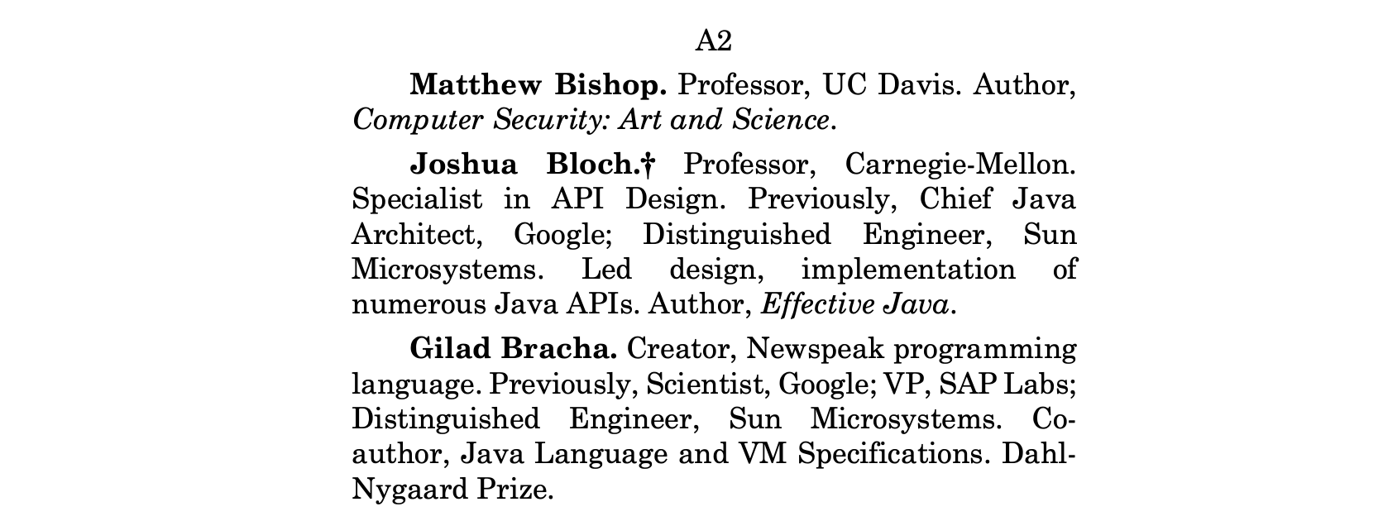

Slide 9
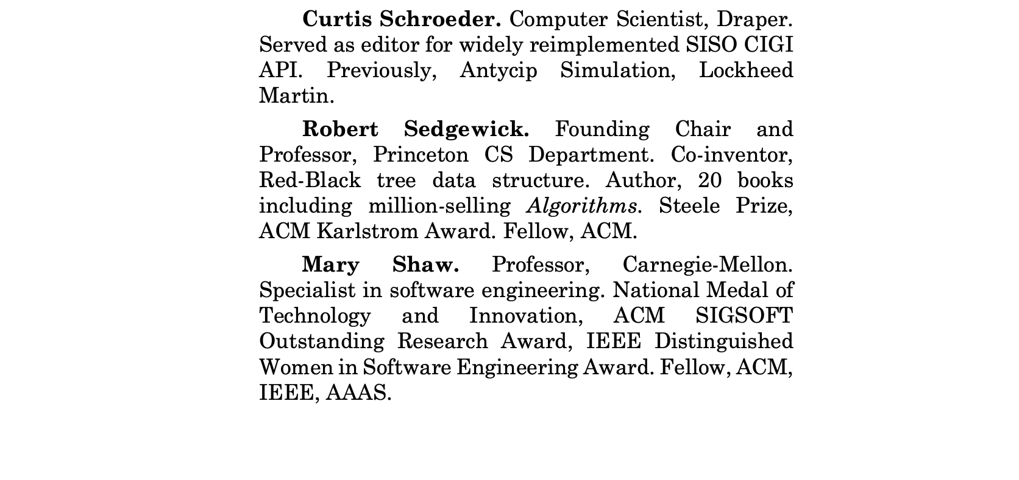

Slide 10
public interface Queue<T> {
boolean isEmpty();
int size();
void enqueue(T item);
T dequeue();
String toString();
}

Slide 11
public class LinkedQueue<T> implements Queue<T> {
public boolean isEmpty(){ … }
public int size() { … }
public void enqueue(T item) { … }
public T dequeue() { … }
public String toString() { … }
}

Slide 12
Protected by copyright.
public class LinkedQueue<T> implements Queue<T> {
public boolean isEmpty(){ … }
public int size() { … }
public void enqueue(T item) { … }
public T dequeue() { … }
public String toString() { … }
}

Slide 13
Whether or not protected by
copyright, subject to fair use.
public interface Queue<T> {
boolean isEmpty();
int size();
void enqueue(T item);
T dequeue();
String toString();
}

Slide 14
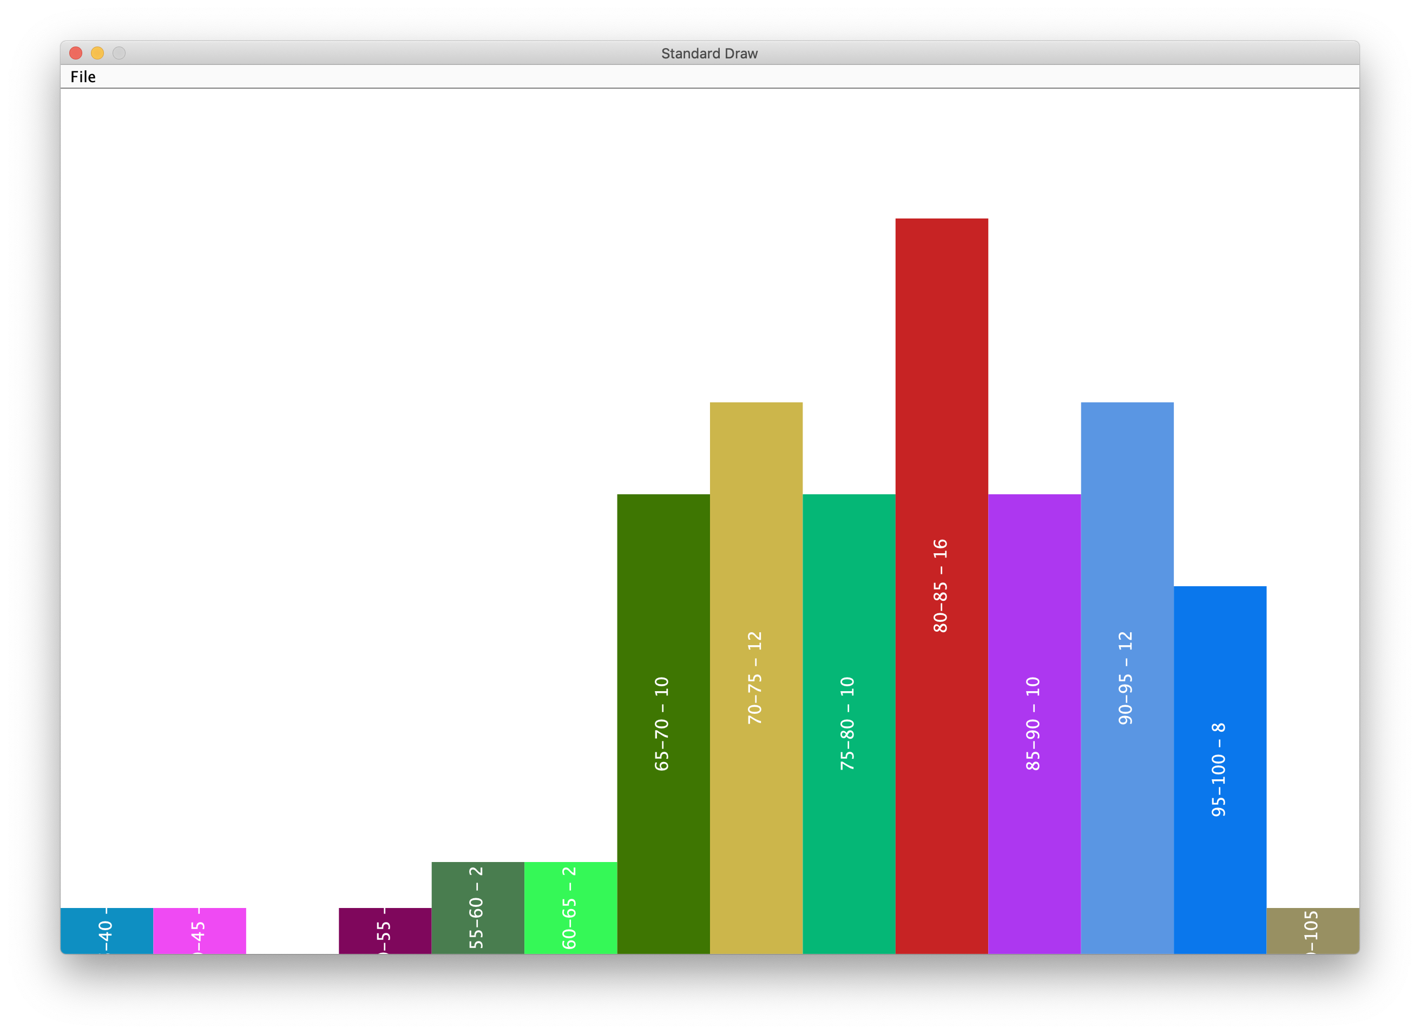
Quiz 2 – average 79

Slide 15
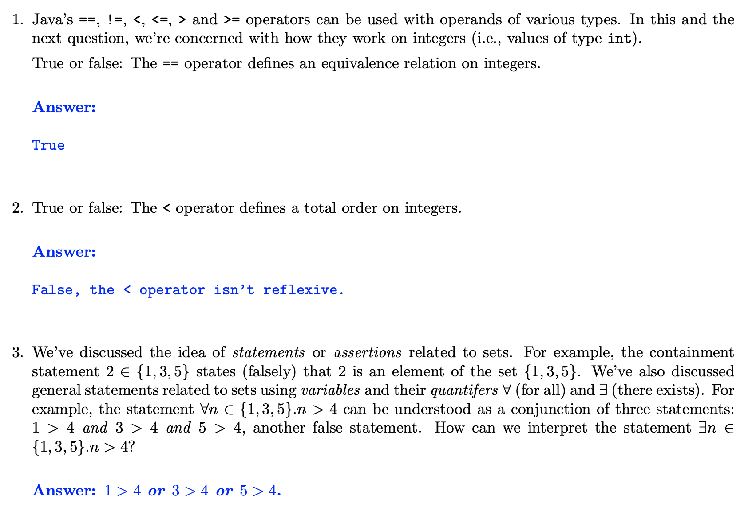

Slide 16
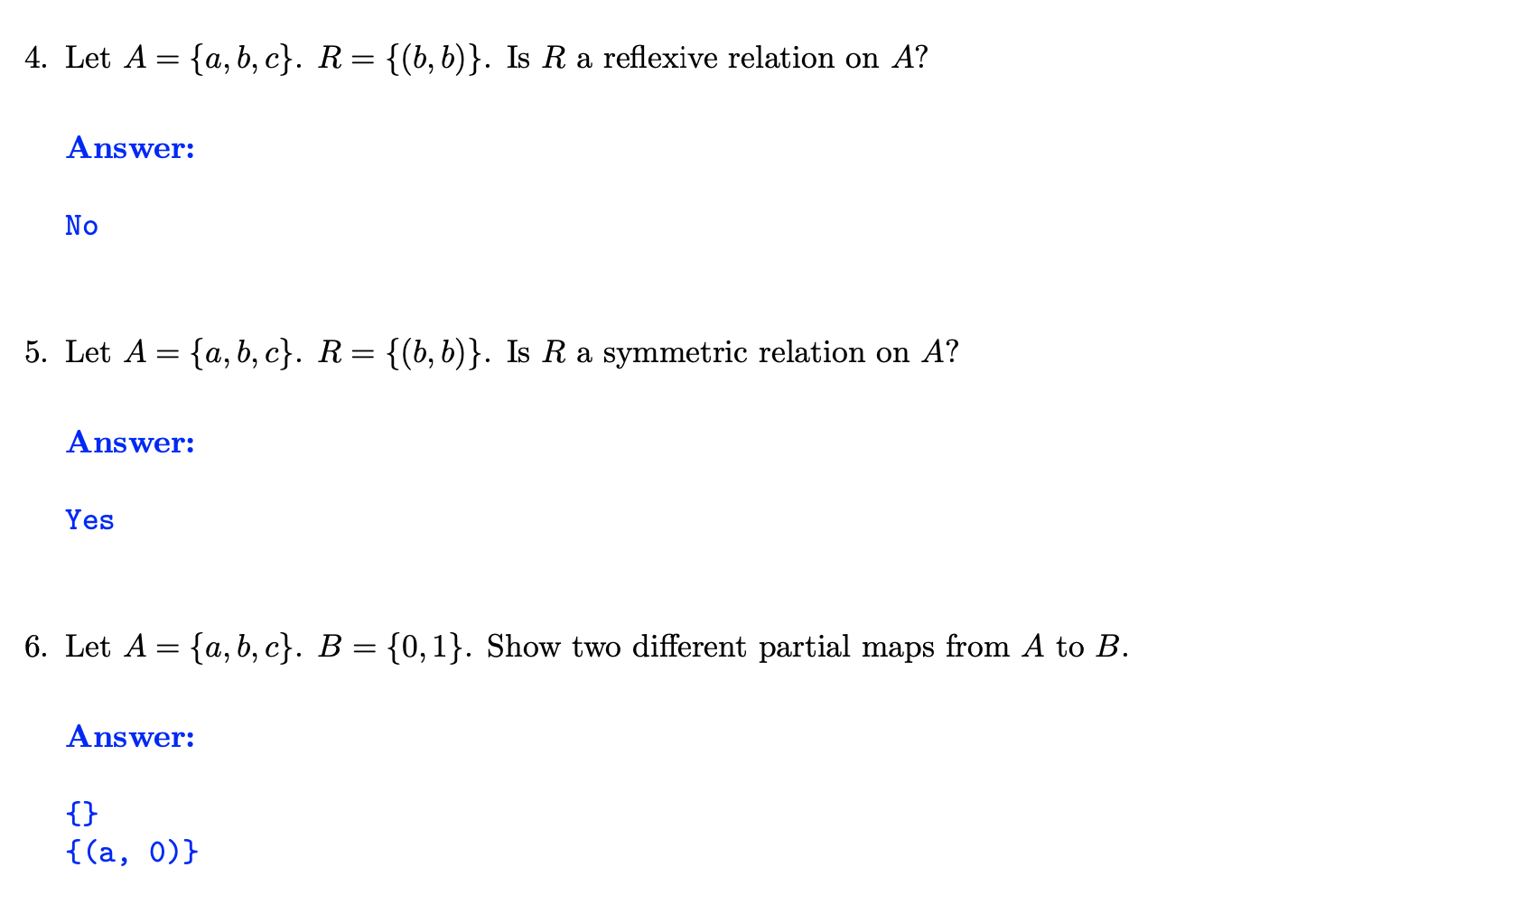

Slide 17
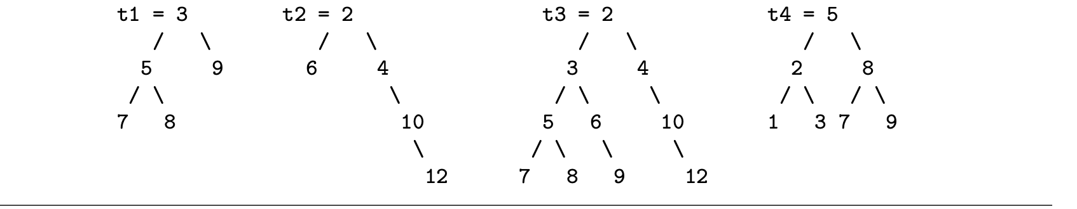
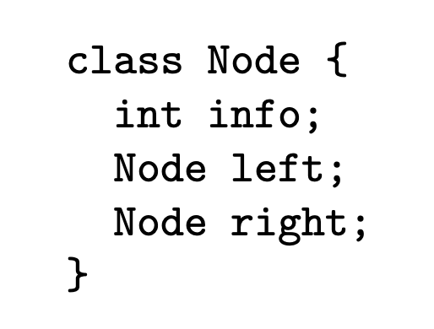

Slide 18
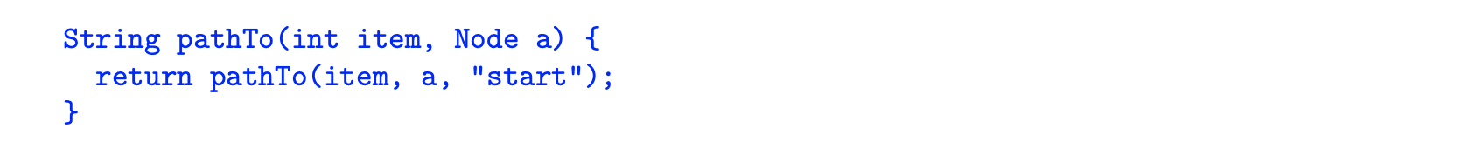

Slide 19
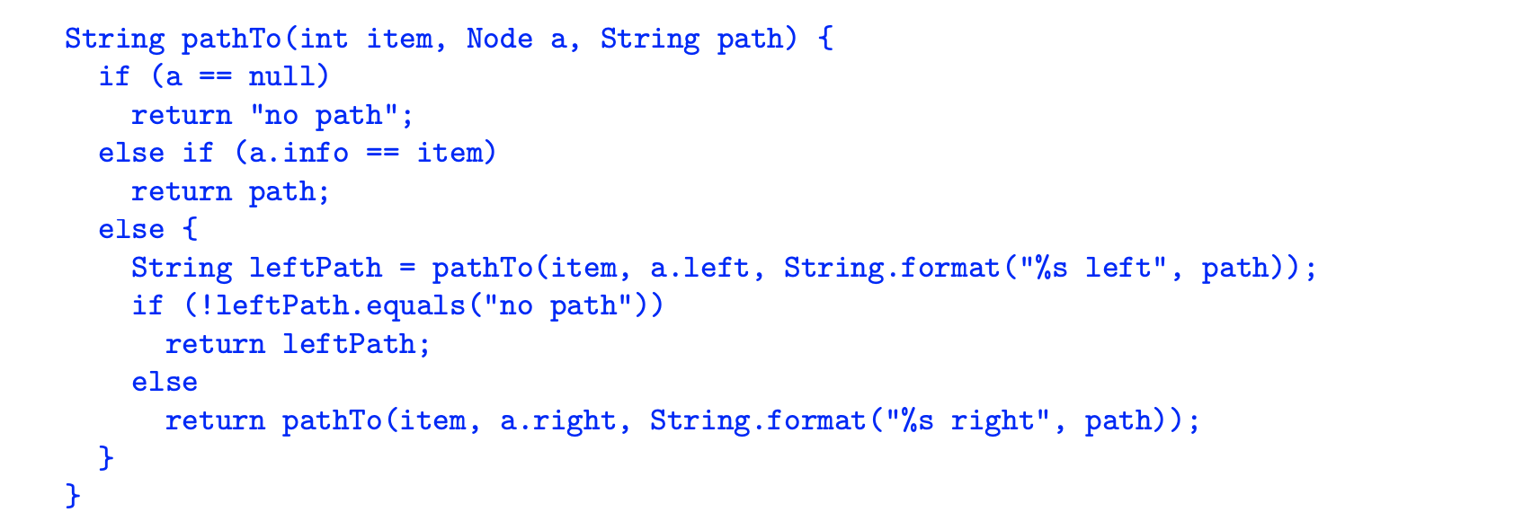

Slide 21
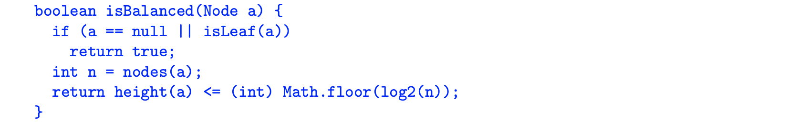

Slide 22
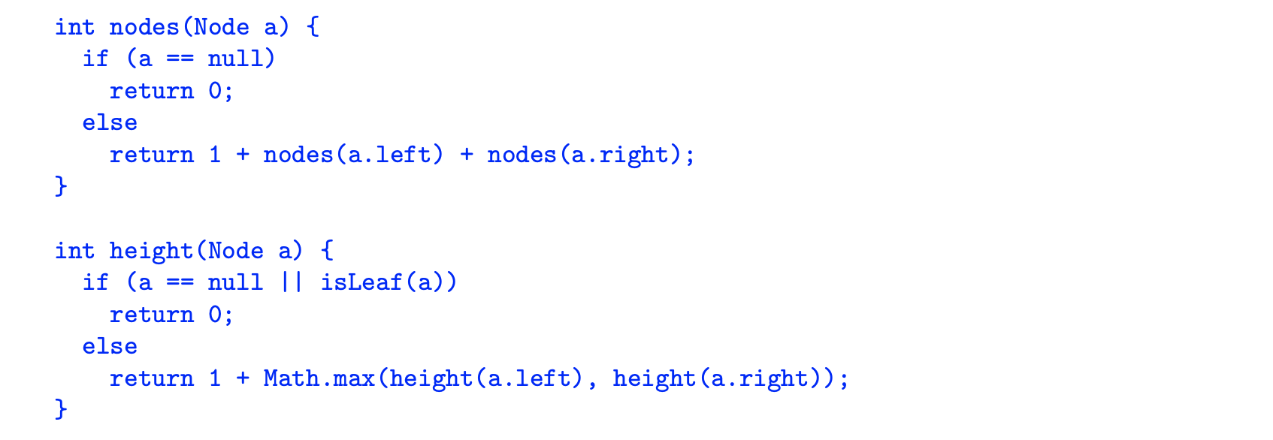

Slide 24
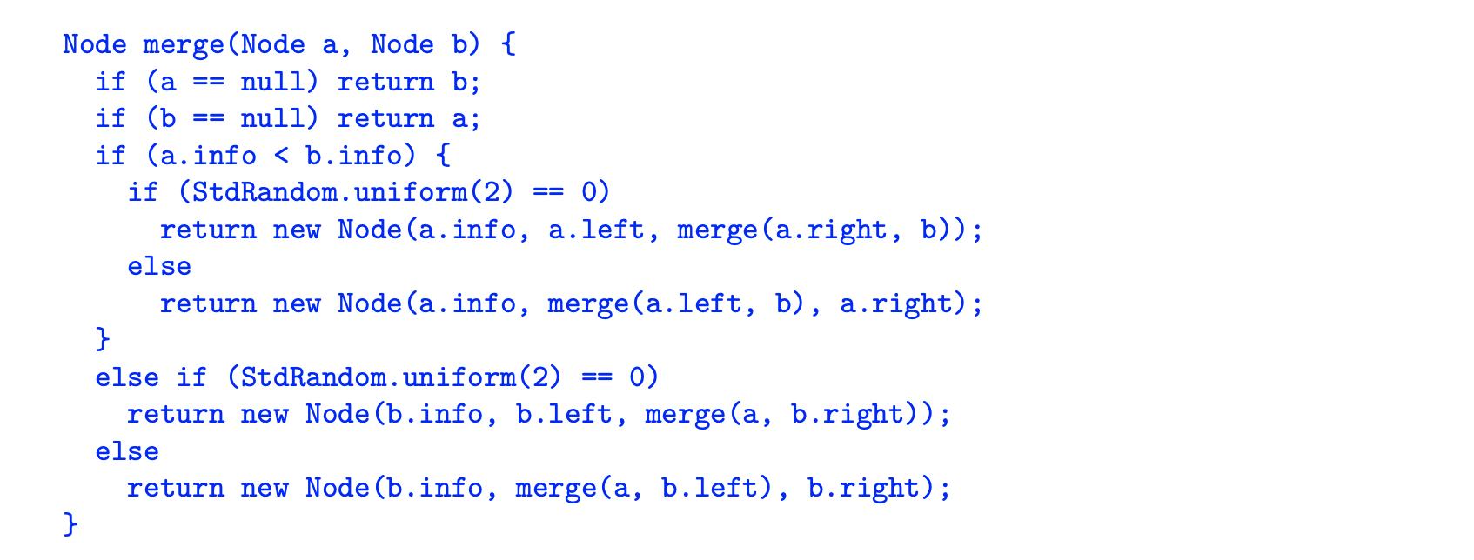

Slide 25
The Huffman Coding Tree
7
0
1
A₄
3
0
1
M₁
2
B₁ L₁
0
1
M = 00, B = 010; L = 011; A = 1

Slide 26
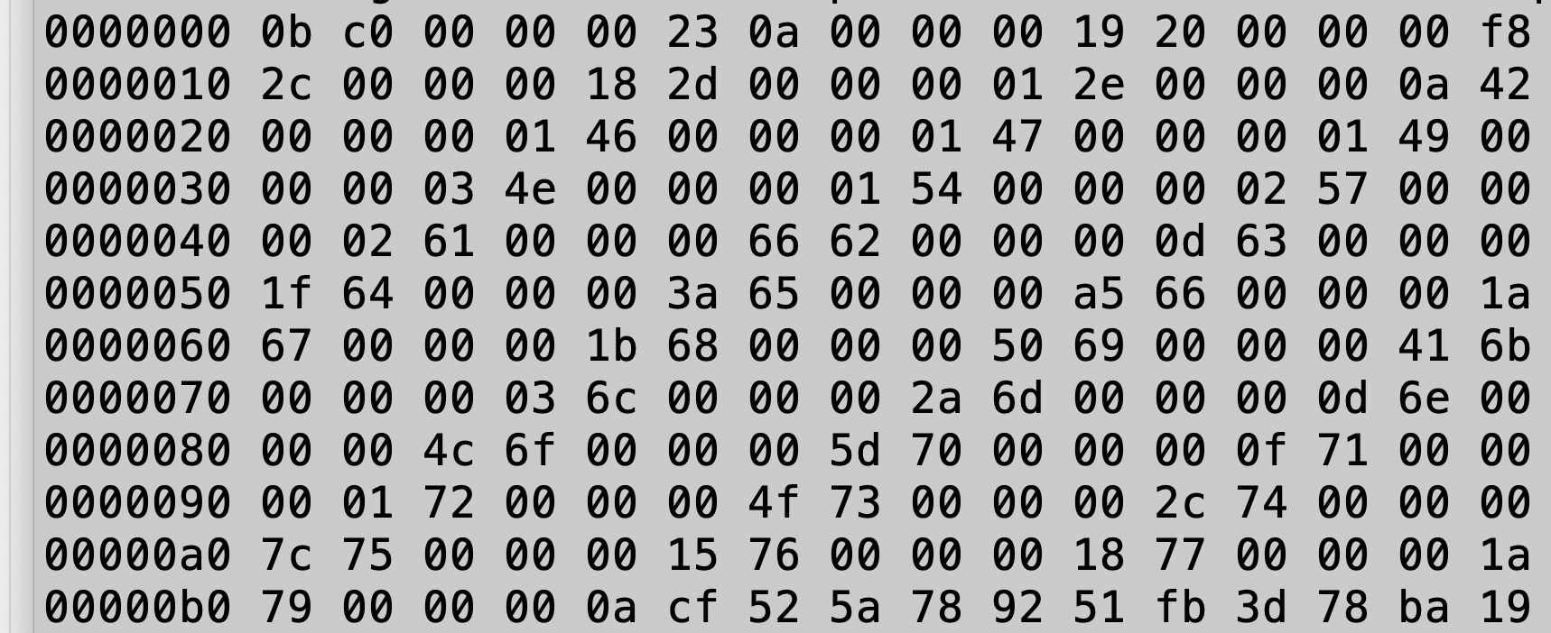
Unix hexdump of lincoln.zip

Slide 27
magic number 0x0bc0

Slide 28
Frequency table size 0x23 = 35₁₀

Slide 29
Table entry: 0x0a = newline, 0x19 =25₁₀

Slide 30
Frequency Table

Slide 31
Start of Bit Stream

Slide 32
Finite Partial Maps
aka
Dictionaries
Symbol Tables

Slide 33
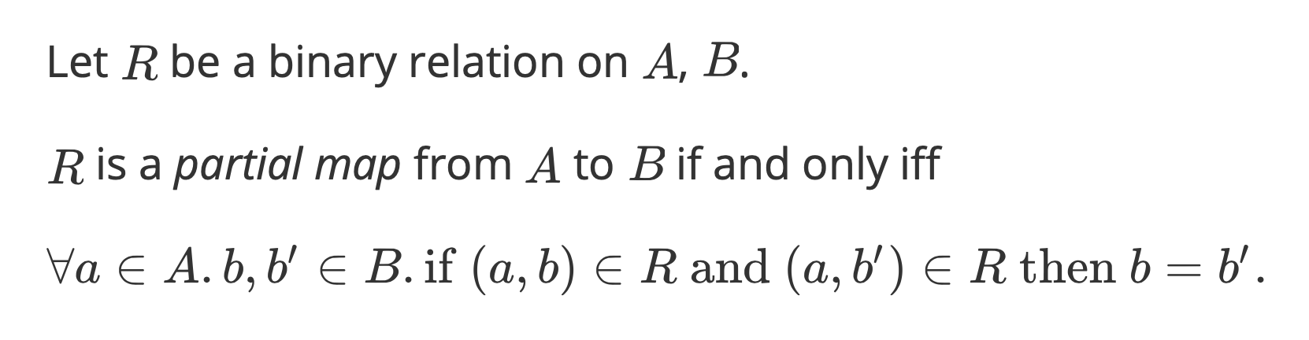
Finite Partial Maps
A – a set of keys
B – a set of values

Slide 34
{ “Alice” : 12, “Bob” : 8 }

Slide 35
General Considerations
Must be able to find a key => need a reasonable equivalence relation on keys.

Slide 36
General Considerations
Must be able to find a key => need a reasonable equivalence relation on keys.
What to do if key isn’t in the map?
Return null – heads up: using null for 2nd purpose here
Throw a java.util.NoSuchElementException
Return java.util.Optional.empty()

Slide 37
General Considerations
Which operations need to be fast?
Worst case? Average case? Amortized?
What about storage?
Locality?

Slide 38
General Considerations
Which operations need to be fast?
Worst case? Average case? Amortized?
What about storage?
Locality?
Should the implementation be mutable or immutable?

Slide 39
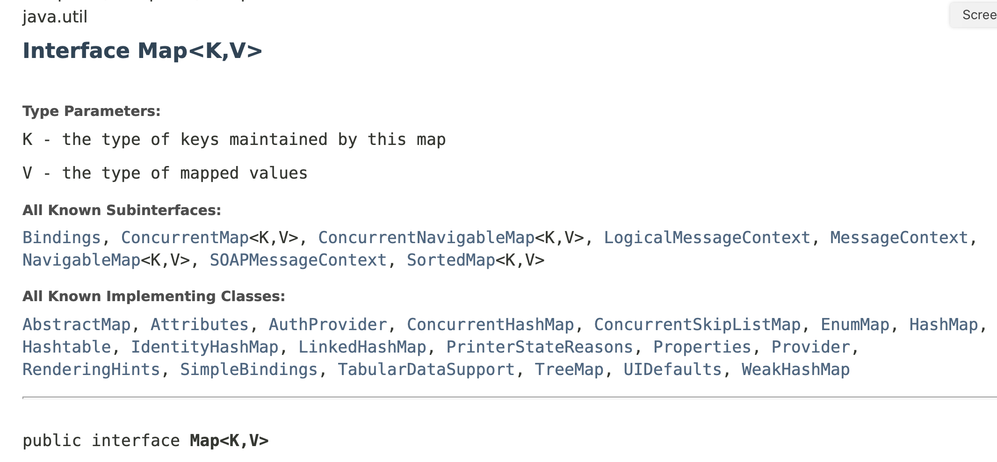

Slide 40
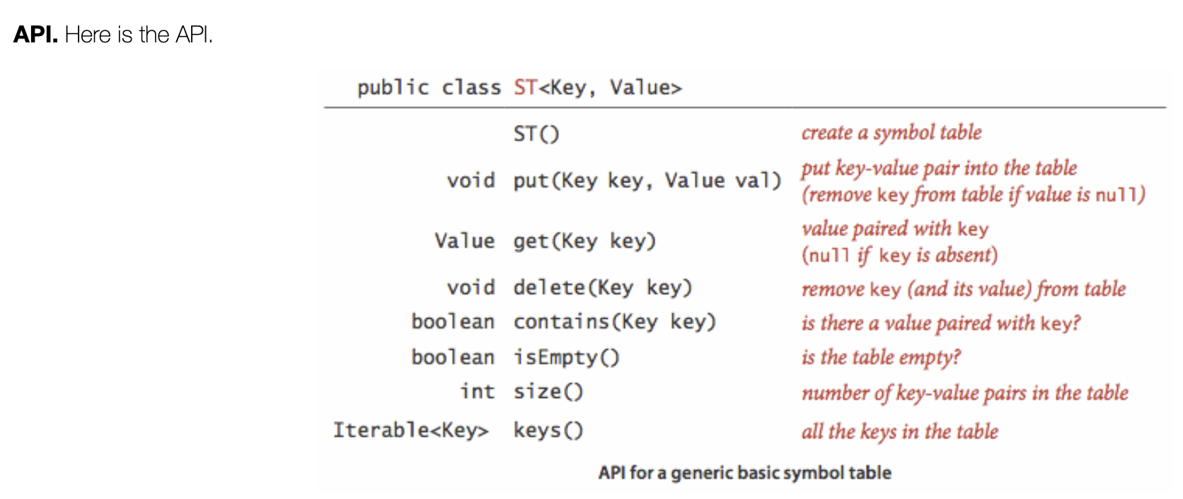
Sedgewick & Wayne’s “API”

Slide 41
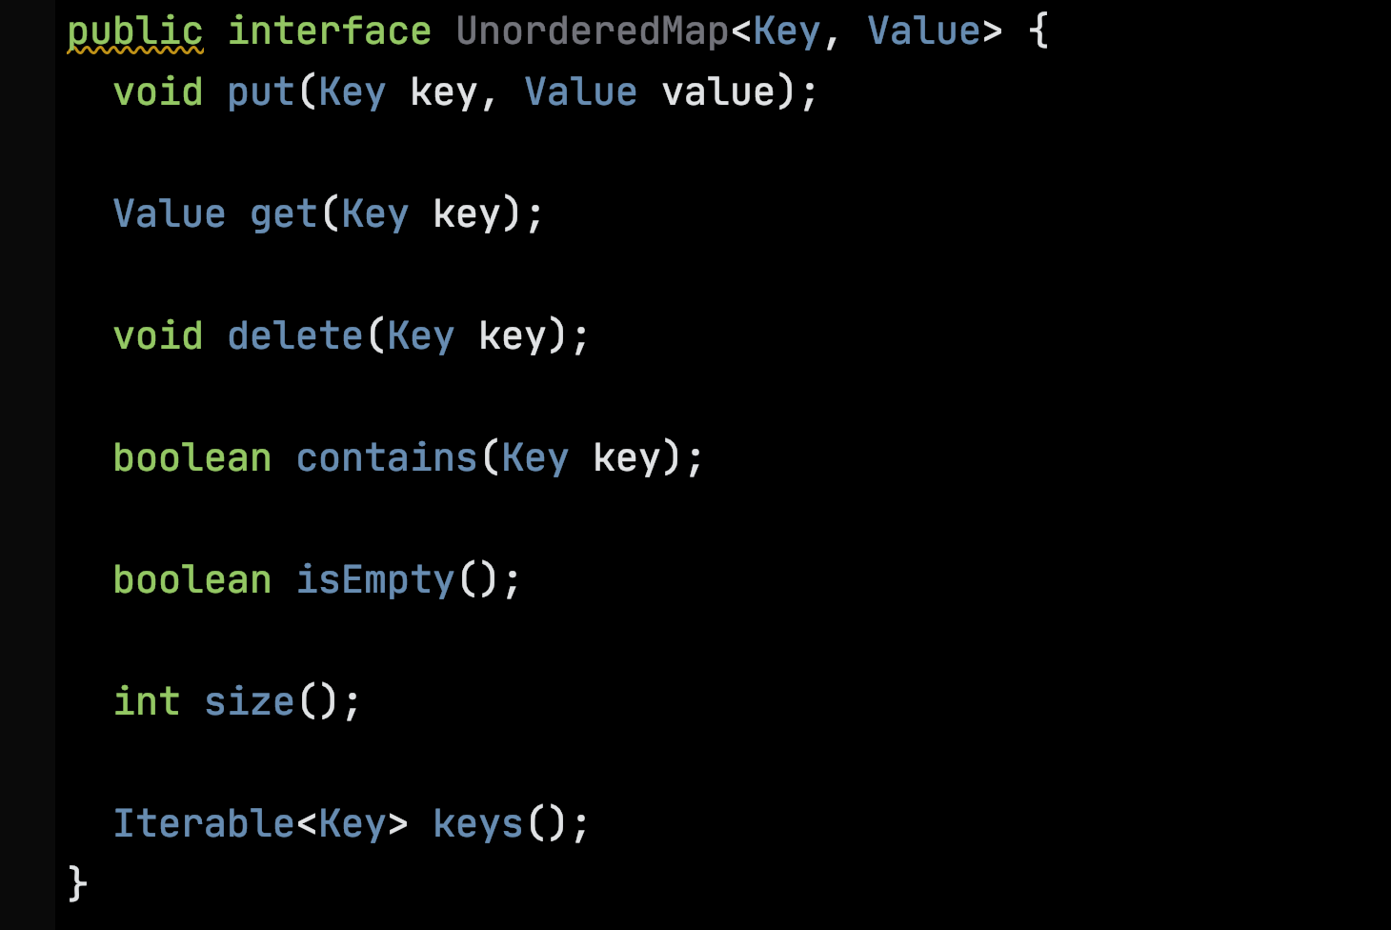
We use interfaces for APIs

Slide 42
Ordered or Sorted Maps
If there is a total order on keys – Ordered (or Sorted) Maps
can implement additional operations related to the order and
can consider data structures supporting efficient operations leveraging the order.

Slide 43
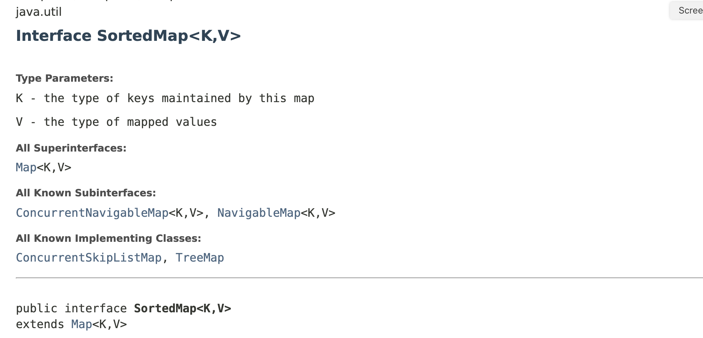

Slide 44
Implementations
Simple binary search trees (Ordered, SW 3.2)
Balanced binary search trees (Ordered, SW 3.3)
Hash Tables (Unordered, SW 3.4)
Skip Lists (Ordered, not covered in SW)

Slide 45
Binary Search Trees
Smaller keys to the left
Larger keys to the right
M
H
R
bst.get(K)
E
K

Slide 46
Operations on BSTs must Preserve the Invariants

Slide 47
BSTs: Smaller to the left, larger to the right
M
M
bst.put(S, 3)
H
R
H
R
E
K
E
K
S

Slide 48
If the tree is balanced, log₂ insertion and find time.
M
H
R
E
K

Slide 49
Structure of tree depends on insertion order.
With an unlucky insertion order, the tree behaves like a singly-linked list.
R
M
H
E

Slide 50
Balanced binary search trees ensure that the tree remains well-balanced.
M
H
R
E
K

Slide 51
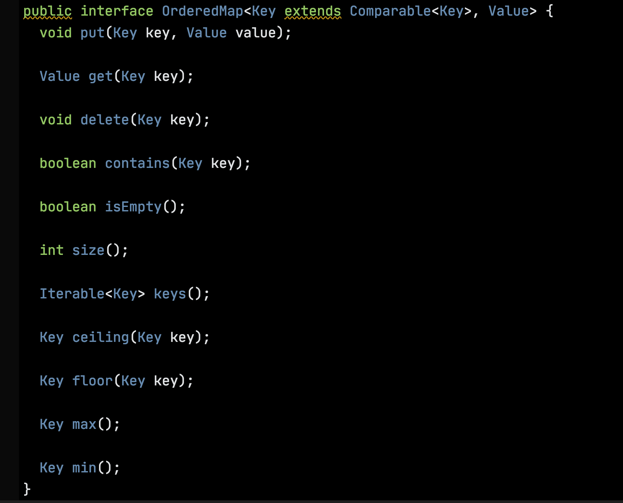

Slide 52
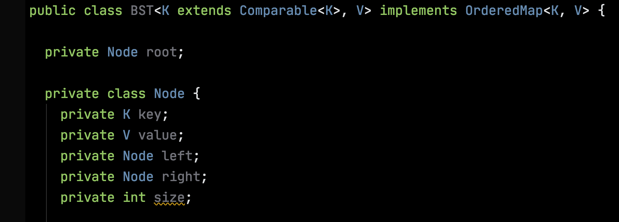

Slide 53
Finding the minimal key E – go left.
Finding the maximal key R – go right.
M
H
R
E
K

Slide 54
The ceiling of key H is H.
The ceiling of N is R.
The ceiling of J is K.
The ceiling of S
doesn’t exist.
M
H
R
E
K

Slide 55
Next time:
How to delete a key?
M
H
R
E
K

